Slide 1

Enhancing Performance with SQL Stored Procedures & UDF
by Ravisankar Pandian

Slide 2


Topics covered
What is Stored Procedure?
The What, Why & How
What is UDF?
The What, Why & How
Enhancing Performance for SPs and UDFs
Do’s
Do Not’s
Some good use cases
Tips
New Features
Conclusion
Programmers.io Confidential and Proprietary

Slide 3


Objectives
Take away from the session:
General overview of Stored Procedures & UDFs
Good understating of how UDFs and SPs perform
Best practices for handling larger data / building application logic
Session is Useful for:
RPG Developers
DB2 SQL Developers
Programmers.io Confidential and Proprietary

Slide 4
Stored Procedure – the WHAT?
A Stored Procedure is a compiled program that can execute SQL statements.
Program object is stored on the DB2 database.
It is like running STRSQL and exec-sql but with some special powers.
Stored Procedure can be called from any application program (Java or Python or any front-end app) that has access to the DB2 database.
It can be called from IBMi command line as well.
Programmers.io Confidential and Proprietary
Notes:
SP -> Loops, conditional logic, code blocks, passing parameters etc.,

Slide 5
Stored Procedure – the WHY?
Reduce network traffic.
Locks are not held across the network transmissions.
Centralized code.
Security & Integrity.
Code Reusability.
Easily comprehensible by cross platform teams.
A good skillset to have for IBM’ers.
Programmers.io Confidential and Proprietary

Slide 6
Stored Procedure – with and without
With Stored Procedure | Without Stored Procedure
Decreased Network Traffic | Increased Network Traffic
Reduced Resource Contention (locks) | Increased Resource Contention (locks)
More Security | End Users can manipulate SQL Statements & Variables
Code Reusability | May lead to code redundancy
Encapsulation of Business Logic | Harder to Manage & Update
Easily Comprehensible by other teams | Harder to comprehend the business logic
Programmers.io Confidential and Proprietary

Slide 7
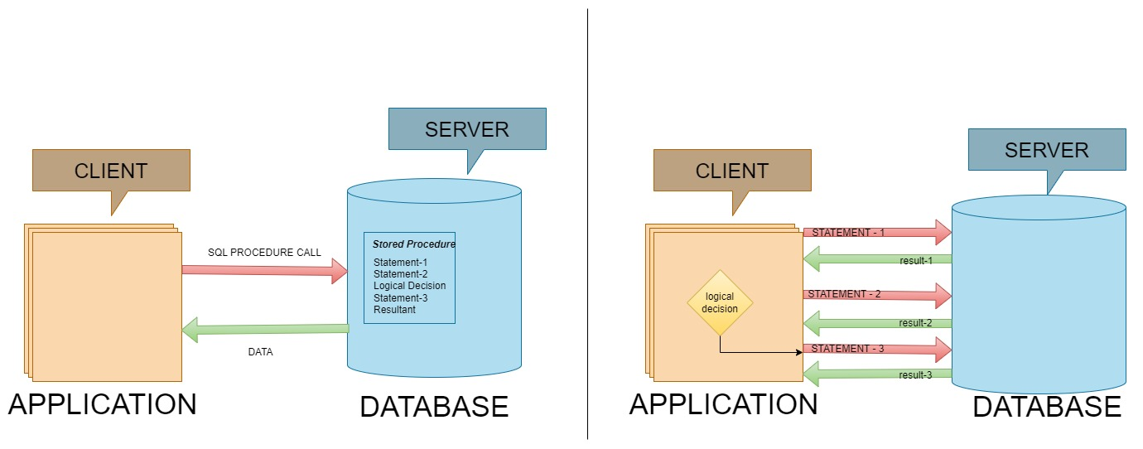
With Stored Procedure
Without Stored Procedure
Programmers.io Confidential and Proprietary
Notes:
A sample note
This is another line

Slide 8
Stored Procedure – the types?
INTERNAL STORED PROCEDURE | EXTERNAL STORED PROCEDURE
Based on procedural extensions to the SQL Language. | Based on high-level-language like C, CL, RPG and COBOL
Straight forward database manipulation | Allows Complex & Sophisticated processing.
For existing systems, business logic need to be ported to SQL Language. | Existing code can be reused.
Open up the IBMi to front-end
Can be used, With and without parameters, With and without result sets.
Programmers.io Confidential and Proprietary
Notes:
Usage of arrays, data structures, built-in-functions, sub-procedures
Core of the business logic can be encapsulated for clients to use.

Slide 9
Stored Procedure – the types?
Based on the type of definition
TYPES | USE CASE
Without Parameter | Insert predefined records.
With In Parameter | Kick start the Day-End or Month-end process from front-end.
With In & Out Parameter | Get the day of the week in text.
Result sets | Pass the multiple records to the front end
Programmers.io Confidential and Proprietary
Notes:
Insert 5 records to Depts table.
Insert a employee record with some information.
Get the day of the week.
Get the 20 records of employee table.

Slide 10
Stored Procedure – the HOW?
Let’s see it in action!
Programmers.io Confidential and Proprietary
Notes:
w/o Parameter

Slide 11
Stored Procedure – the HOW?
Types
Internal SP
Without Parameter – Insert 5 record into the depts table
With In Parameter
With InOut Parameter
Results Sets
External SP
Without Parameter
With In Parameter
With InOut Parameter
Results Sets
Show the catalog tables once the SP is compiled for any one example
Programmers.io Confidential and Proprietary
Notes:
w/o Parameter

Slide 12
User Defined Function – the WHAT?
Add UDF Definition
Program object is stored on the DB2 database.
But we already have SP, how does it differs from UDF.
It can be used on any SQL Statements
Programmers.io Confidential and Proprietary

Slide 13
User Defined Function – the WHY?
They are useful for encapsulating common calculations or complex queries
Show a diff b/w column for w and w/o sp.
Add a diagram for both w and w/o sp.
Clean and Modular Code
Pros and Cons
A good skillset to have for IBM’ers.
Programmers.io Confidential and Proprietary

Slide 14
User Defined Function – the HOW?
Types
Without Parameter
Mathematical Calculation – NO DB Involved
With DB Involvement.
Look into the table returning UDF.
Need to create a database for this session
Programmers.io Confidential and Proprietary

Slide 15
Questions and Answers
Thank you

